Slide 1
CHANGE DETECTION
OF DEFORESTATION
USING SATELLITE IMAGES….

Slide 2
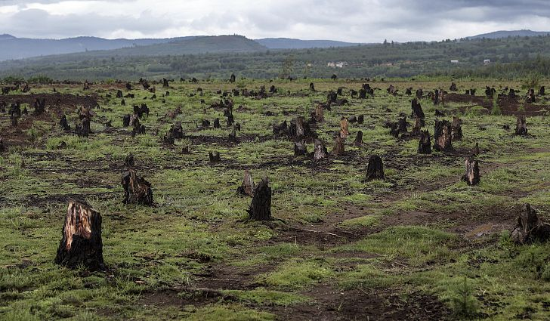
INTRODUCTION:
The earth's surface is changing as a result of natural
phenomena or human activity, for example, wildfires, lightning
strikes, storms, pests, agro-forestry, agricultural expansion,social,
economic, technological, historical factors and urban growth.

Slide 3
PROBLEM STATEMENT:
Permanent destruction of forests to make the land available for other uses is increasing rapidly form last several years. Consequences are related to increased emissions of greenhouse gases, pollution of water, and loss of biodiversity.
Change detection for deforestation is the problem of detecting the changes in the earth where people are intentionally trying to destroy the forest areas.
Images collected from Satellite needs real-time change detection of such activities timely, so that, the deforestation can be saved before they get destroyed.

Slide 4
It can be significantly advantageous if we can detect the changes from the Satellite images but, it is not feasible to track the changes manually in the Satellite images.
There is a need of an automated system which can provide some meaningful information by processing large number of images timely and yet accurate.
Nowadays, Computer Vision and Deep Learning based solutions are becoming popular to detect and track the changes from large number of images.

Slide 5
In this research, a novel Machine learning based change detection method will be exploited for detecting the changes in the Satellite images.
One of the challenges in applying Deep Learning based model to change detection is, applying such models on large number of images requires lot of processing power and time.
On successful completion of the project it will deliver the functionality that will enable to detect the changes from Satellite images for deforestation.

Slide 6
METHODOLOGY:
Step 1:
Data collection and dataset preparation -This will involve collection of publicly available Satellite image dataset from available sources.
Step2 :
The method of change detection is based on Image Processing Techniques, image fusion, Fuzzy clustering, Difference Image (DI). In DI, the idea is to generate DI by comparing two images pixel by pixel. Differencing and rationing are the well-known methods for DI.

Slide 7
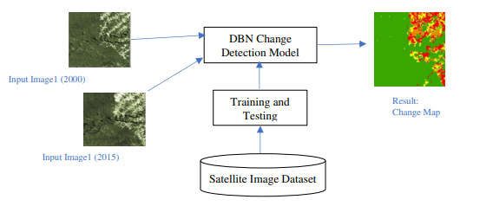

Step 3: Training and experimentation on datasets The change detection model will be trained on the huge data set to get the accuracy.

Slide 8
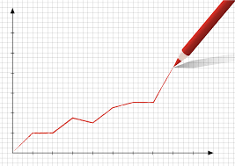
Step 4: After the change detection through the image processing is being done based on the decreasing rate of the deforestation the prediction is being done for the future years with the help of a graph.

